Slide 1
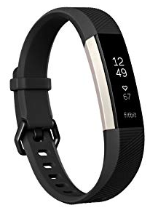
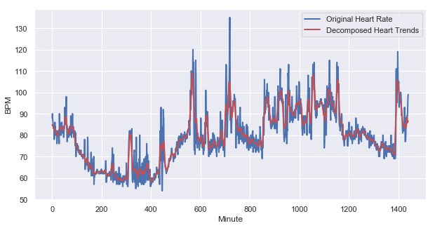
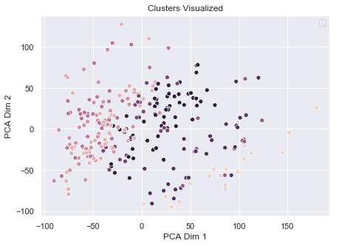
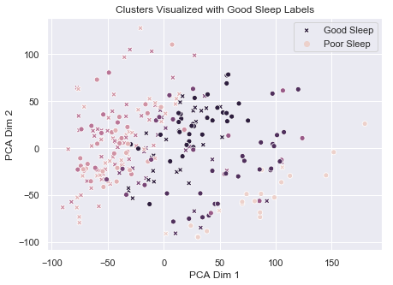
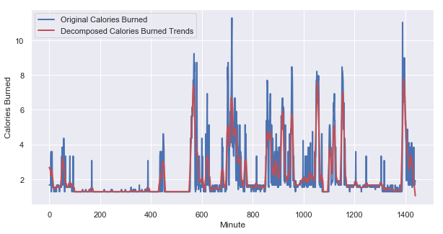
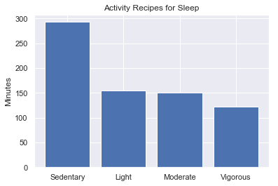
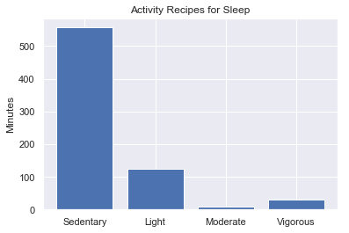
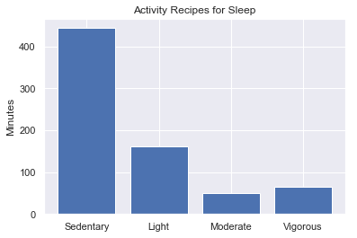
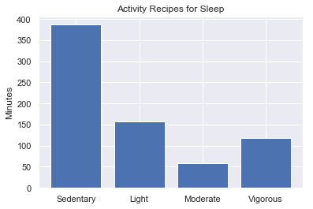
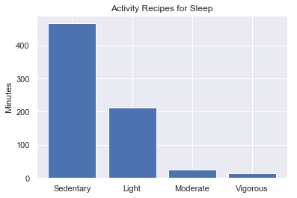
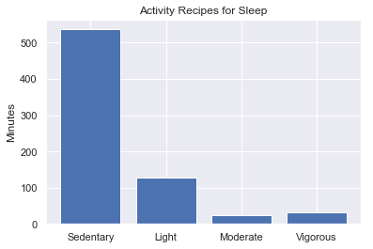
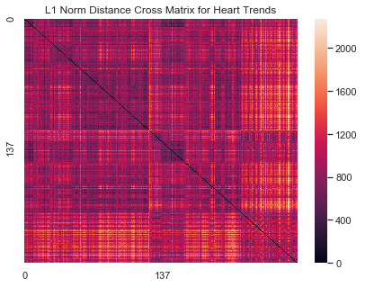
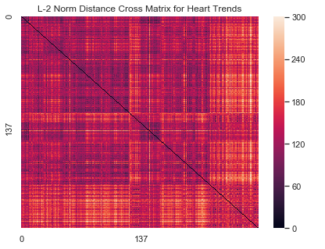
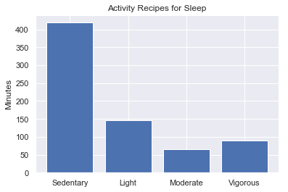
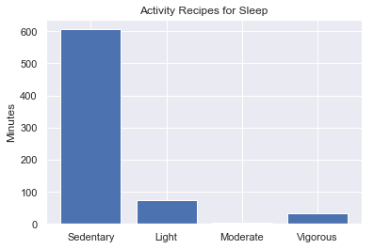
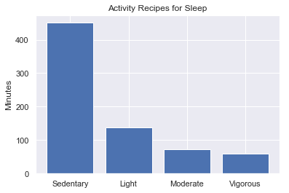
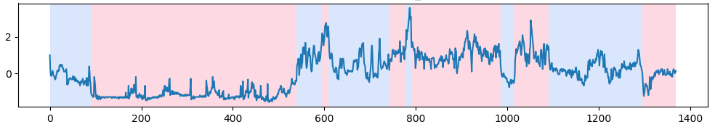
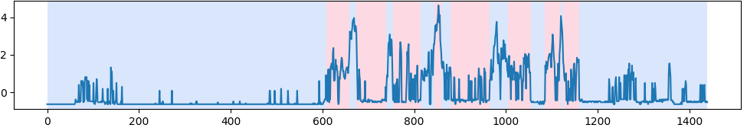
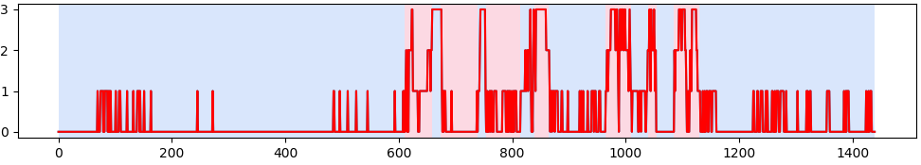
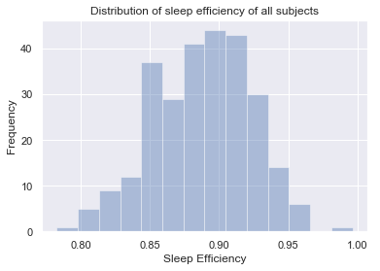
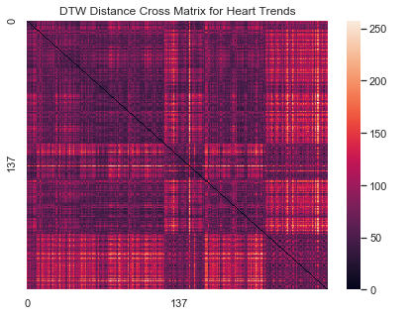
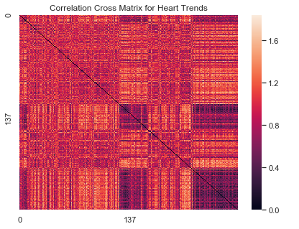
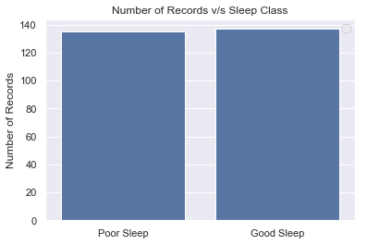
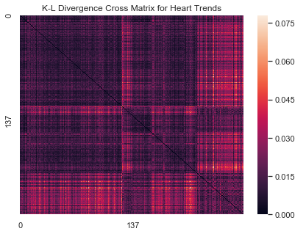
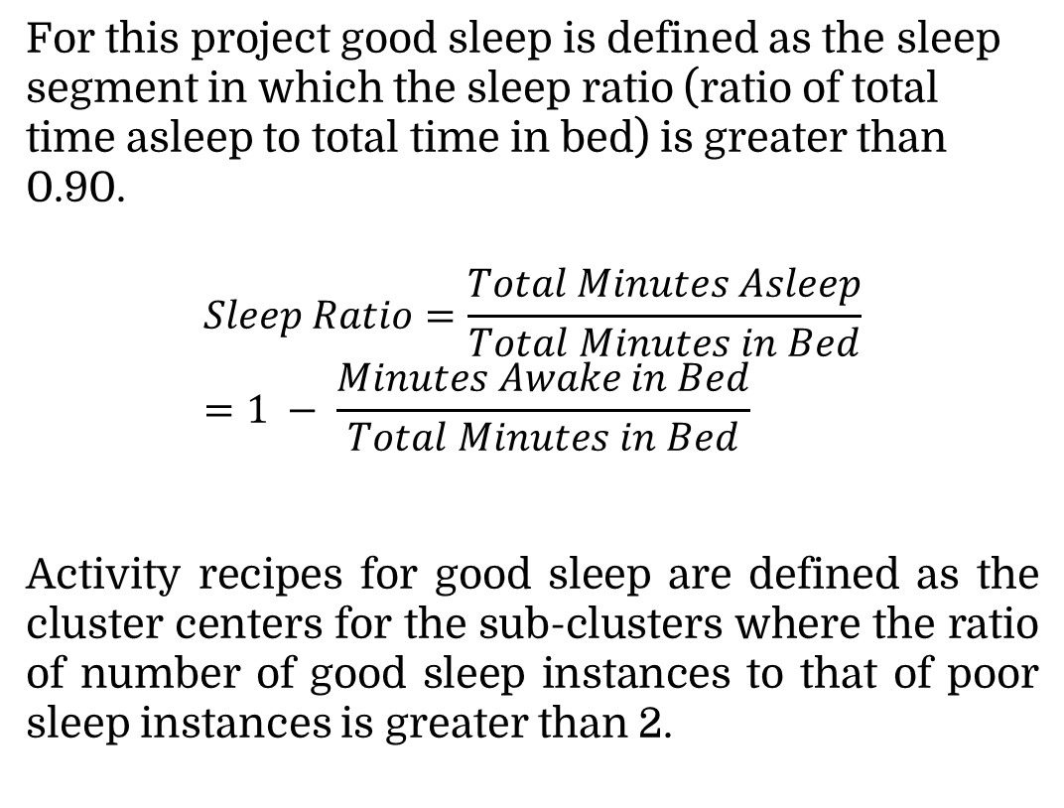
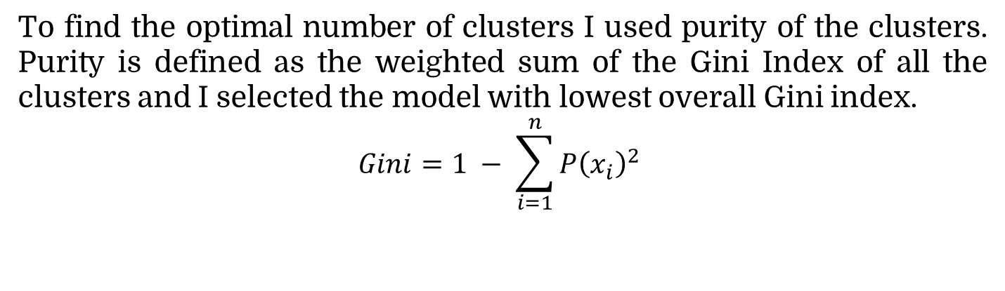
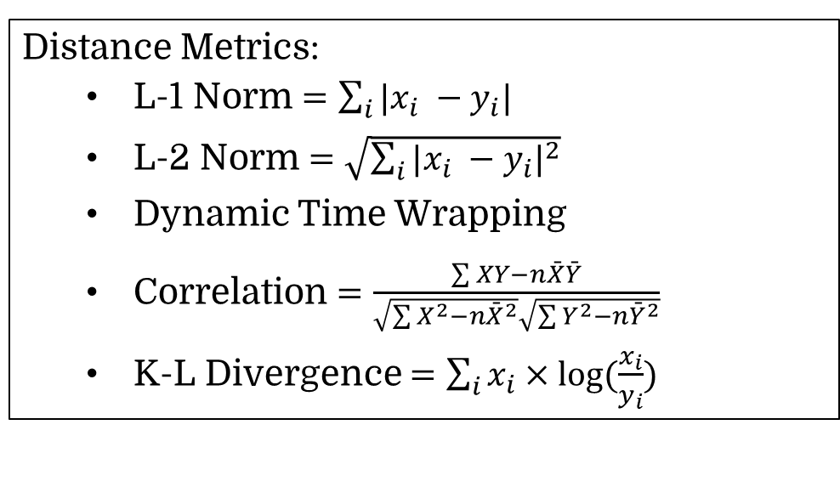
Activity Recipes for High Sleep Efficiency
using Wearable Device Data
Saksham Goel | goelx029 | 5138568
Mentor: Meghna Singh, Professor: Jaideep Srivastava
Department of Computer Science, University of Minnesota Twin Cities
Abstract
Methodology
Results
My project aims to apply clustering techniques over intraday time series data collected from wearable devices like Fitbit, to help extract activity recipes for high sleep efficiency, which will further be supplied to an activity recommendation engine. In this project I am trying to evaluate different distance measures and their effectiveness in processing time series data for heart rate, calories, steps, sleep and activity. For this project I focused on clustering heart rate time series using different distance metrics like L-1 Norm, L-2 Norm (Euclidean), Dynamic Time Warping (DTW), and Kullback Leibler Divergence for evaluating the performance of the activity level recipes learned from these clusters that would in turn be used for recommendations for improving sleep efficiency.
Data Collection: For this project I collected data from Fitbit API for 4 people over a time period of 4 months. The data consisted of intraday time series data of sleep, steps, calories, and heart rate.
Data Cleaning: After collecting the data, we preprocessed it by removing NaN values using means found in hourly segments corresponding to each user.
Distance Metric | Purity of Clustering | Avg. Purity of Activity Recipe Clusters
L-1 Norm | 0.5473 | 2.13
L-2 Norm | 0.5848 | 2.34
DTW | 0.6372 | 2.59
Correlation | 0.6516 | 3.12
K-L Divergence | 0.7006 | 4.18
Fitbit Web API
FITBIT DB
Feature Extraction: The time series data was smoothed using a seasonal decomposition using moving averages. The window length was 10 minutes to avoid loss of information by over generalization.
Data Collection Script
Table: Comparison of different distance metric functions over clustering purity
Intraday Data
(Heart, Sleep, Activity, Steps)
LAB DB
Data Validation and Cleaning
Feature Extraction
Figure: Trends extracted from the raw heart rate data
Introduction
Figure: Cluster Assignments of heart rate trends using K-L Divergence
Figure: Cluster Purity of Sleep Labels using K-L Divergence over heart rate trends
Inadequate sleep negatively affects both mental and physical well-being, and exacerbates many non-communicable health problems such as diabetes, depression, cancer and obesity. Therefore a good night’s sleep is of paramount importance to each person for their overall well being. My project aims to extract high confidence, actionable knowledge of activity recipes for high sleep efficiency from low cost, ubiquitous, low fidelity data for health and wellness from wearable devices like Fitbit. These activity recipes will further be supplied to an activity recommendation engine for providing continuous recommendations to users during their daily routines.
There has been research done on recommending activities based on recipes learned from clustering over activity patterns of the user data. However this project aims to use data about a person’s current health being i.e. heart rate data, to group biologically similar people into clusters and then learn their activity patterns to recommend activities. In this project I have applied K-Means clustering over intraday time series data in two steps to find the clusters and learn the best activity recipes for high sleep efficiency.
To find the optimal number of clusters I used purity of the clusters. Purity is defined as the weighted sum of the Gini Index of all the clusters and I selected the model with lowest overall Gini index.
$$Gini=1 − \sum_{i=1}^{n}{P{\left(x_{i}\right)}^{2}}$$
Optimal number of clusters
K-Means Clustering
Figure: Trends extracted from the raw calories rate data
Distance Metrics:
L-1 Norm $=\sum_{i}{|x_{i} −y_{i}|}$
L-2 Norm $=\sqrt{\sum_{i}{{|x_{i} −y_{i}|}^{2}}}$
Dynamic Time Wrapping
Correlation $=\frac{\sum{XY−n\bar{X}\bar{Y}}}{\sqrt{\sum{X^{2}−n{\bar{X}}^{2}}}\sqrt{\sum{Y^{2}−n{\bar{Y}}^{2}}}}$
K-L Divergence $=\sum_{i}{x_{i}×log⁡(\frac{x_{i}}{y_{i}})}$
After the initial clustering step, I applied K-Means clustering again on each of the clusters individually. This clustering step is applied over the activity level summaries of the day. Activity level summaries are defined as amount of time a person performs certain activity level from the time they wake up to current time. I used the similarity distance metric in order to find sub-clusters that can separate days which lead to good sleep from days that lead to poor sleep.
Sub Clusters Clustering
Activity Recommendation
Figure: Activity Recipes for good sleep found using K-L Divergence distance metric
Good Sleep Activity Recipes Extraction
Conclusions
From this project we can conclude that using K-L Divergence proved to be the best distance metric for clustering heart rate trends to separate good sleep days from bad sleep days. Also we find that using a clustering base approach helps in finding numerous different types of activity recipes for good sleep which denote different types of schedules. The activity recipes include intense activity days to relaxed days. This just shows that different day can lead to different type of activity recipe which would lead to good sleep which is expected. Also using heart rate as the principal feature vector for clustering we are able to find clusters which contained very different activity recipes together hence enriching the recipes learned.
For this project good sleep is defined as the sleep segment in which the sleep ratio (ratio of total time asleep to total time in bed) is greater than 0.90.
$$Sleep Ratio=\frac{Total Minutes Asleep}{Total Minutes in Bed}=1 − \frac{Minutes Awake in Bed}{Total Minutes in Bed}$$
Activity recipes for good sleep are defined as the cluster centers for the sub-clusters where the ratio of number of good sleep instances to that of poor sleep instances is greater than 2.
Figure: Comparison of different Distance Metrics used for Clustering using Distance Cross Matrix over Heart rate and Calories Time Series data. The x-axis and y-axis represent each record in ordered form from good sleep to poor sleep. Because of this we expect to see a different color patch between the quadrants across the top down and bottom up diagonal

